Slide 1
Autonomous Control System
Team 2: Hari Gunasekara, Syed Rizvi, Doowon Kim, Aiden Kim

Slide 2
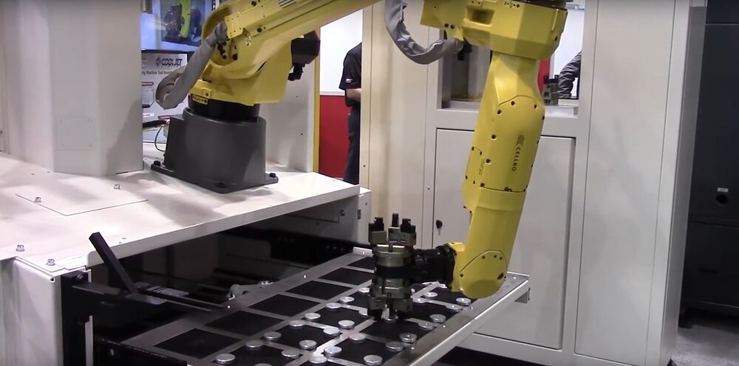
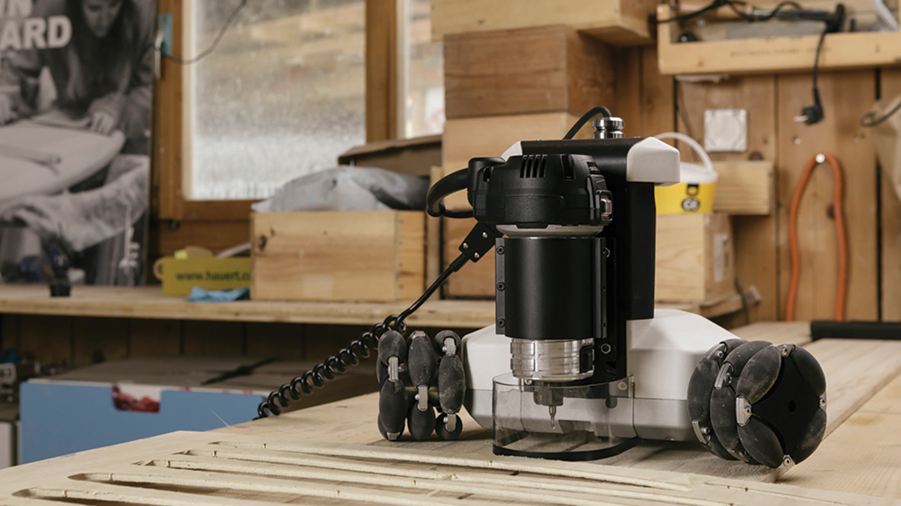
Background
Sponsor: Dr.Lee
Object Detection
Notes:
Project sponsored by Dr. Lee
Had other projects on the plate, but our groups being interested in a mechatronics projects with control systems,
Motive: Dr. Lee wants a basis for how to implement some of these control system in certain applications: object detection

Slide 3
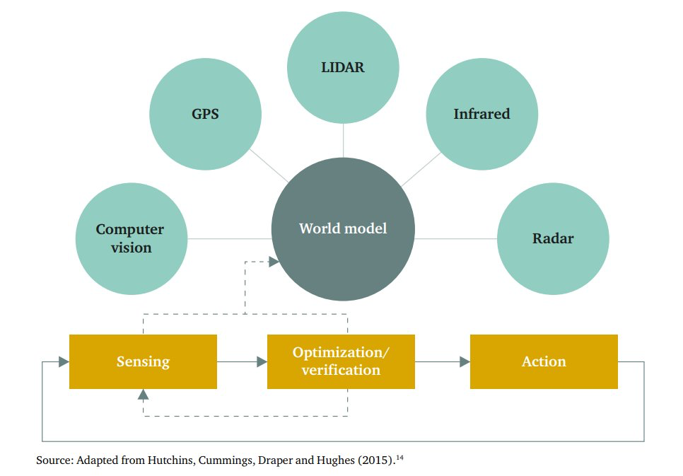
Autonomous system (Next big thing!)
Notes:
Get data or information from sensing components like GPS, Lidar…
Processed into world model. And parameters in the dynamic models must be optimized and verified

Slide 4
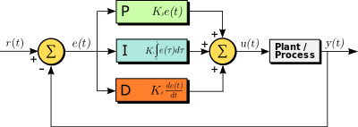
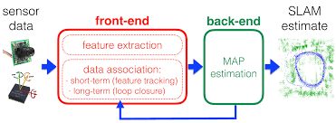
Control Methods
Conventional PID:
Artificial Intelligence:
Notes:
Two methods to explore, implement and compare for our project
Conventional PID method which is generally used for a lot of these machining applications
Rise of artificial intelligence technology and increase in computing power.
Data is filtered, feature extraction

Slide 5
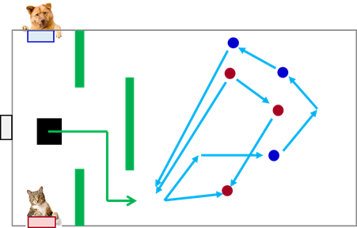
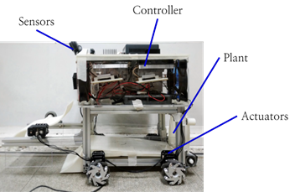
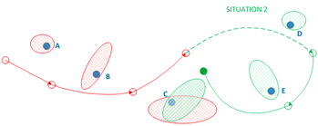
Project Overview
Compare PID and AI control methods based on time and accuracy
Notes:
Using the two methods,
Have a motored vehicle,
Create a setup with these paths and obstacles of different color
Outcome result is a program that identifies the different colored objects and maps their positions, certain degree of confidence.
Compare the two control methods based on time and accuracy to complete the task.

Slide 6
Motor Vehicle
Components:
DC motors with encoder
Raspberry Pi
Lidar
Camera
etc
CAD design to hold the components
Notes:
The type of work that would go into this project is:
First need a motored vehicle.
Looked at few papers done for this kind of problem, and created a list of components based on that
CAD design to hold the components probably on Solidworks and make it out of 3D printing, then we would have our motored vehicle.

Slide 7
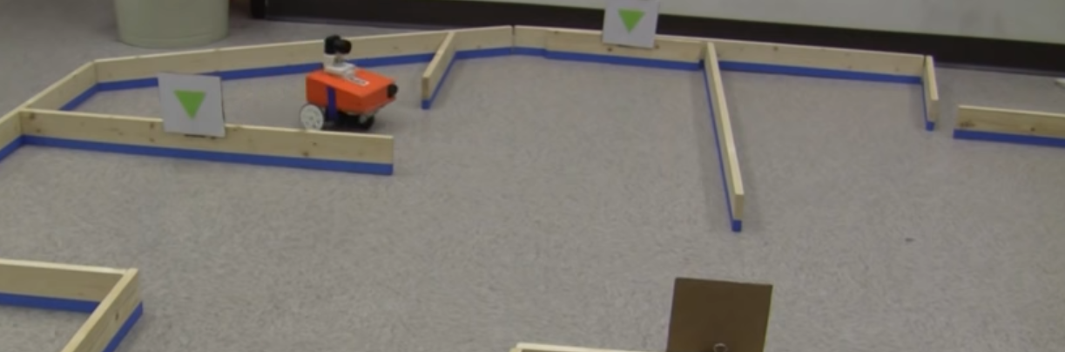
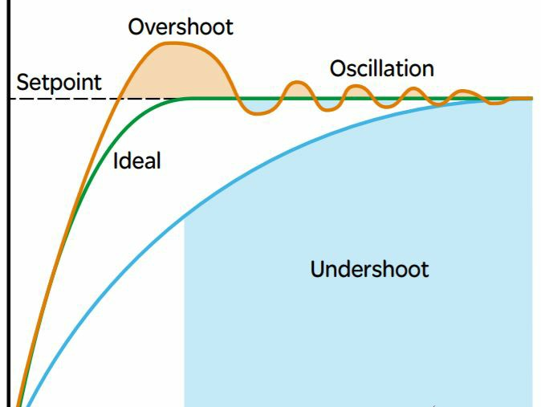
Conventional PID system
Notes:
Once we have motored vehicle,
Implement our conventional PID system.
Again, we found few papers that uses PID control for object detection, so we will have the logics and algorithms for controlling our system.
Then, once we set up PID system,
Set up experiments or tests to optimize those gains

Slide 8
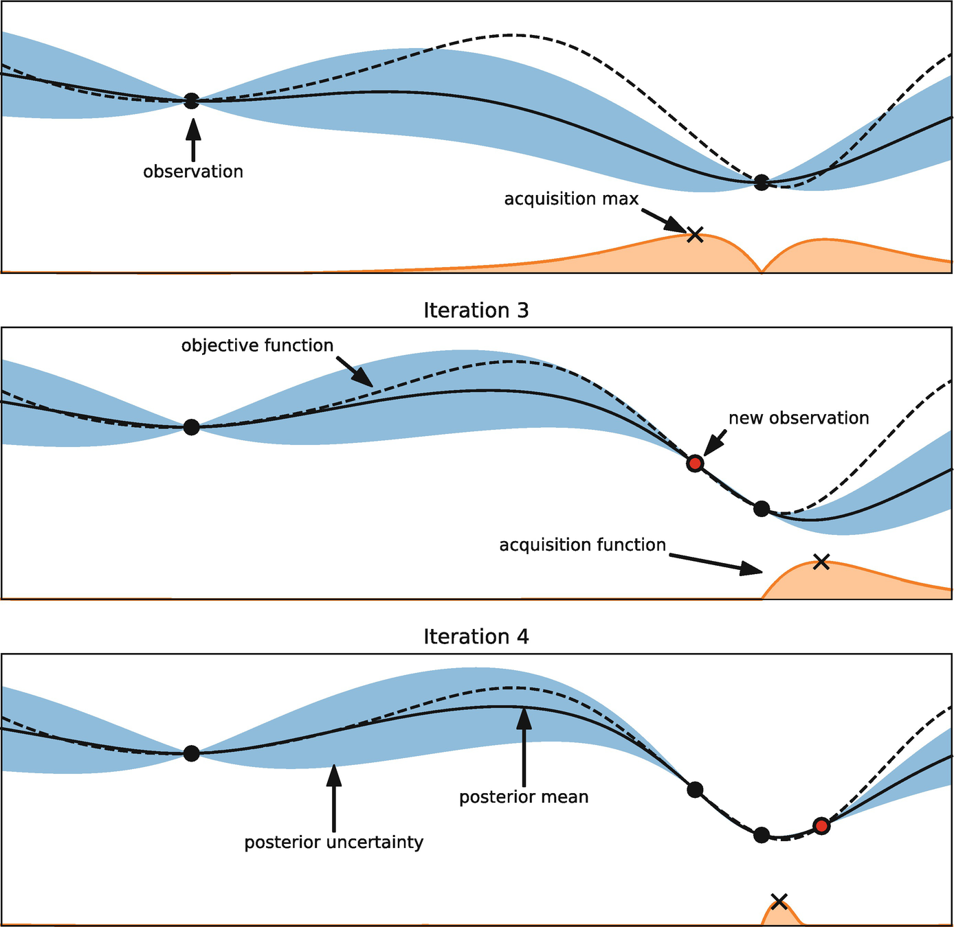
Artificial Intelligence
Machine learning techniques, SLAM (simultaneous localization and mapping), Image processing, etc
Notes:
Less straight forward than PID from previous slide
So like for map estimations, we would require techniques like
Need to review some literatures to see what’s the best approach and what kind of techniques are required for this kind of problems.
And similarly, we would run this through like an experiment to optimize certain parameters such as hyperparameters for our machine learning model
For example this picture on the right is an illustration of hyperparameter tuning using baysian optimzation.
Where we choose an acquisition function and as we increase the number of observations, from like a experiment
We can tune the hyperparameters to have the model predict more confidently close to our true solutions.

Slide 9
Deliverables
CAD design and the manufactured frame integrated with sensors, actuators, etc.
Program for object detection and mapping:
Conventional PID control
Artificial intelligence based control .
Technical documentation comparing the performance results.
Notes:
Technical documentation comparing performance results between the two methods,
Saying which one is better and why
And which methods would be recommended for certain applications.

Slide 10
References
Farag, Wael. (2019). Complex Trajectory Tracking Using PID Control for Autonomous Driving. International Journal of Intelligent Transportation Systems Research. 10.1007/s13177-019-00204-2.
L. Zhang, L. Wei, P. Shen, W. Wei, G. Zhu and J. Song, "Semantic SLAM Based on Object Detection and Improved Octomap," in IEEE Access, vol. 6, pp. 75545-75559, 2018, doi: 10.1109/ACCESS.2018.2873617.
Pamungkas, Rizki & Maulana, Arbayu & Sya'ban, Dwi & Ramdani, Rahmat & Musafa, Akhmad & Riyanto, Indra. (2017). WiFi Data Communication System Design for Wheeled Soccer Robot Controller.
Yilmazlar, Eray & Kuscu, Hilmi. (2017). Object Tracking by PID Control and Image Processing On Embedded System. Research Inventy: International Journal of Engineering And Science. 6. 33.
Maulana, Arbayu & Wibisono, Wisesa & Pamungkas, Rizki & Riyanto, Indra & Musafa, Akhmad. (2017). PID Controller-based Object Tracking and Speed Control System for Wheeled Soccer Robot. 10.31227/osf.io/xqu9a.

Slide 11
Project Management

Slide 12
Member Responsibilities
 | Aiden | Doowon | Syed | Hari
Design | - Program language development and software integration | - CAD Design - Mechanical analysis | - Calculation of motors and battery requirements. - Component integrations with code. | - Camera and LIDAR integration
Project Mgmt. | - Take meeting minutes -Manage/organize project files | - Organize and communicate meetings to group members - Organize and lead material procurement | - Communication with external and internal stakeholders. -Cost control and monitoring. | - Take meeting minutes -develop and update project schedule based on progress
Communication | - Create and finalize 25% of presentation | - Create and finalize 25% of presentation - Create and finalize 25% of report | - Create and finalize 25% of presentation - Create and finalize 25% of report | - Create and finalize 25% of presentation

Slide 13
Project Schedule
September | October | November | December | January | February | March | April
Project Setup/ Material Procurement | Concept Design of Conventional PID Method | Design Development and prototyping of Conventional PID Method | Design Testing and Finalization of Conventional PID Method | Concept Design of AI Based Approach | Design Development and prototyping of Design of AI Based Approach | Design Testing and Finalization of AI Based Approach | Comparison of Two Methods and Final Results

Slide 14
Thank you!
Any questions?

